Slide 1
Volusia Flagler family YMCA Liz Kammer Vice President of Youth development

Slide 2
Overview of Volusia Flagler Family Y
The Y is a powerful association of men, women and children from all walks of life joined together by a shared passion: to strengthen the foundations of community.
With a focus on youth development, healthy living and social responsibility, the Y nurtures the potential of every youth and teen, improves the nation’s health and well-being and provides opportunities to give back and support neighbors.
Volusia Flagler Family YMCA is a mid size Y. Located in Volusia County. We have 6 Family Centers and a residence camp.
We have a membership base of over 40,885.
We serve over 10,280 participation in youth sports, aquatics, afterschool and summer day camp programs.

Slide 3
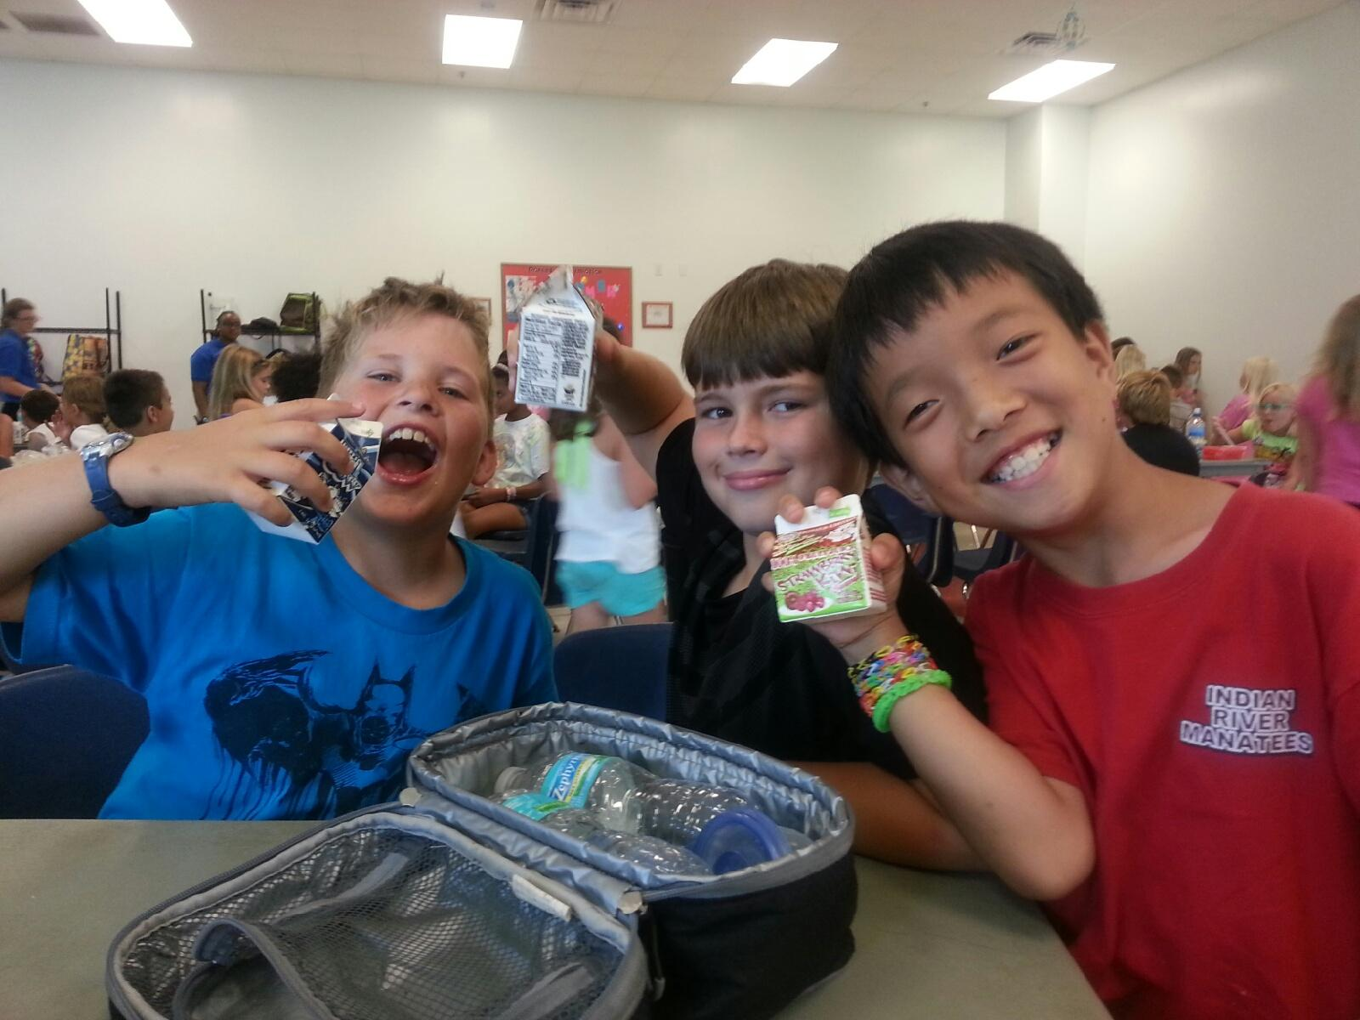
Healthy eating and physical standards
Beverages- Water is accessible and available to children at all times, including at the table during snacks and meals. Provide only water and unflavored low-fat (1%) or nonfat milk (for children 2 or older), family style.
In 2010 we removed all soda from the vending machines in our Centers.
Water is served as drink of choice in our Afterschool Programs and 1% milk is served during our summer food service programs.

Slide 4
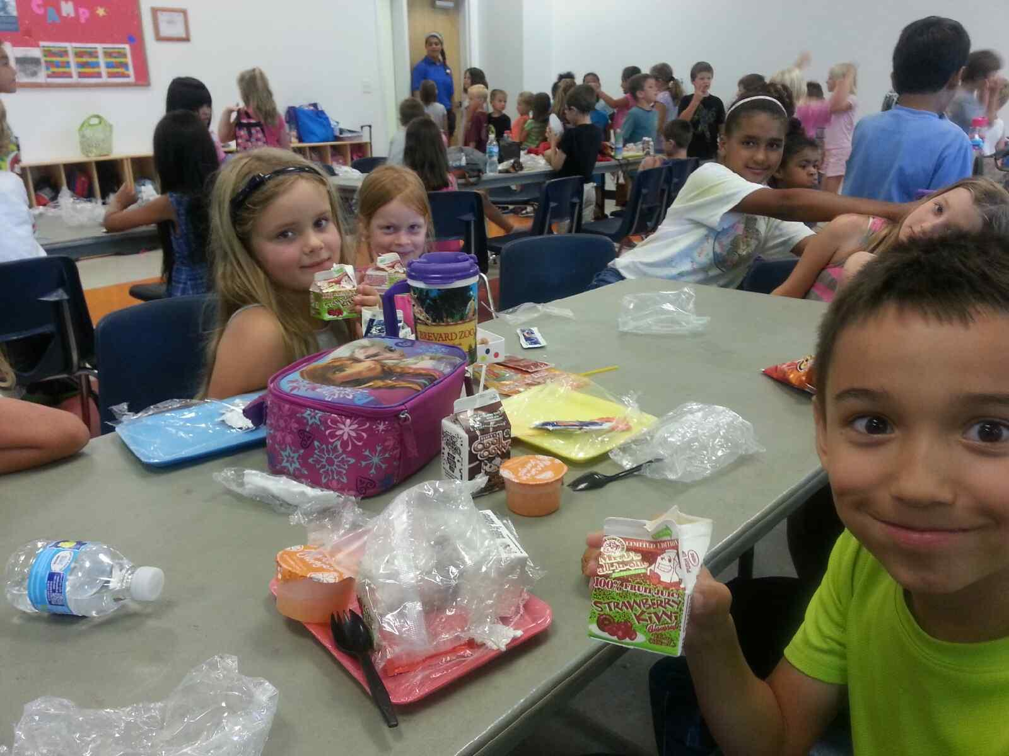
Healthy eating and physical standards
Food- Children serve themselves (family style)
Provide fruits or vegetables at every snack and meal
Do not provide any fried foods or foods that contain trans fat
Offer only whole grains
Provide only food where sugar is not listed as one of the first three ingredients or that contain no more than 8 grams of added sugar per serving.
In 2013 we began adopting the HEPA standards in regard to food in our Afterschool Program. We faced some challenges with the Summer Food Program. So we began working with partners like Florida Impact, the United Way, our sponsor and GA Food Service to offer more nutritious food items.

Slide 5
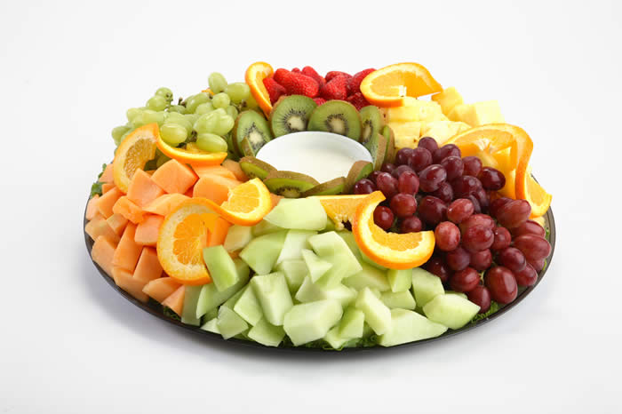
Healthy eating and physical standards
Food Continued- Y staff will model healthy eating behaviors at all times. This includes consuming the same foods and beverages as children during meals and snacks (if possible) and avoiding consumption of foods or beverages that are inconsistent with the HEPA standards during program time.
In 2011 we made changes to the food policies at staff meetings and trainings. We switched from offering donuts and cookies to fresh fruit and bagels, etc.

Slide 6
Healthy eating and physical standards
Physical Activity- Provide children with opportunities for moderate and vigorous physical activity for at least 60 minutes per day during a full- day program or 30 minutes per day for a half-day program.
Include a mixture of moderate and vigorous activity as well as bone and muscle-strengthening activities.
Take active play outdoors whenever possible.
Y staff will model active living by participating in physical activities with children.
We began utilizing SPARK, Healthy Family Home, Food and Fun and USTA 10 & Under Tennis, Kids Zumba, yoga and swimming in Afterschool and Summer Camp Programs.

Slide 7
Healthy eating and physical standards
Screen Time- Eliminate screen time (television, movies, cell phone, video games, computer, and other digital devices) for children under 2 years old. For children over 2, limit screen time to less than 30 minutes per day for children in half-day programs and to less than 1 hour per day for those in full-day programs. During screen time, seek to minimize children’s exposure to commercials and ads marketing unhealthy foods.
In 2010 we eliminated television, movies and video games from all our program areas and increased our physical activity and outdoor play.
If sites utilize computers for homework assistance we have limited the time allotted to 30 minutes.

Slide 8
Next Steps for the Volusia Flagler Family YMCA
Expand HEPA Standards across all our YMCA program areas.
Encourage sports parents and volunteer coaches to provide water at practices and games instead of Capri Sun and other sugary drinks. Also encourage fruit instead of cookies and other snacks.
Switch from only offering snacks in our Afterschool Program to offering suppers daily.
Increase the amount of parental engagement in our programs by using informational materials and/or activities.
Continue to encourage our Staff to adopt the HEPA Standards in their daily lives.

Slide 9
Resources
http://www.ymca.net/hepa/
http://www.sparkpe.org/
http://www.10andundertennis.com/
http://www.foodandfun.org/

Slide 10
Thank you!
Liz Kammer
Volusia Flagler Family YMCA
ekammer@vfymca.org
386-738-9622

