Slide 1
NEMOURS NATIONAL OFFICE OF POLICY & PREVENTION Healthy Eating Physical Activity (HEPA) Action Summit Tuesday, September 1, 2015 Orlando, Florida
Funding for this project was made possible by the Centers for Disease Control (CDC). Nemours is currently funded by the CDC under a five-year Cooperative Agreement (1U58DP004102) to support states in launching ECE learning collaboratives focused on obesity prevention. Its contents are solely the responsibility of the authors and do not necessarily represent the official views of the Department of Health and Human Services, Centers for Disease Control and Prevention, or the U.S. Government.

Slide 2
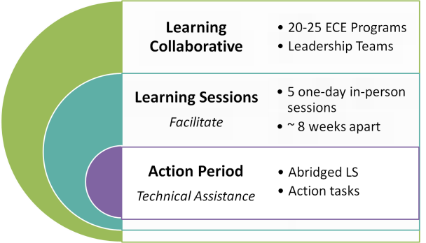
ECE Learning Collaborative Model
Notes:
Provide a brief overview of the Learning Collaborative Model using the diagram so participants can visually see what was said on the previous slide and expand into more detail around the Learning Sessions and Action Periods;
the next two slides will provide an overview of the Learning Sessions and Action Periods.
Explain the italicized “Facilitate” and “Technical Assistance” - those are the roles the trainers play for each.

Slide 3
Learning Sessions
Why Should
We Change?
Go NAP SACC*
How Can We Continue to Make Healthy Changes?
Long-Term Action Plan
Celebrating Success:
Our Plans in Action!
Continue Long-Term Action Plan
LS1
Action Period
LS2
LS3
LS4
LS5
Action Period
Action Period
Action Period
Action Period
What is Our Role in
Making Healthy Changes?
How Can We Engage Families as Partners?
Continue Long-Term Action Plan (Emphasis on Parent Engagement)
*Go NAP SACC is a Nutrition and Physical Activity Self Assessment for Child Care for ECE settings comparing their current practices with a set of best practices
Notes:
This is a brief overview of how the Learning Sessions will roll out over the course of the year. Make note of the continuous use of Action Planning and the use of Storyboards to communicate the process of change.
Learning sessions are ACTIVE: Providers will explore and experience the resources they will be sharing with the staff in their programs – all to help support kids moving, learning and acquiring health habits.
Following each Learning Session is what we call the “Action Period”. During this time, the Leadership Teams will go back to their program staff to facilitate an abridged version of the Learning Session they just attended and work on a specific task and complete staff worksheets before the next Learning Session. This Action Period enables the entire ECE program to learn, play, assess, plan for and implement healthy change TOGETHER – empowering program staff as agents of change.
After Learning Session 1 (LS1), programs will complete Go NAP SACC as part of their Action Period to assess their strengths and areas of improvement to plan healthy changes.

Slide 4
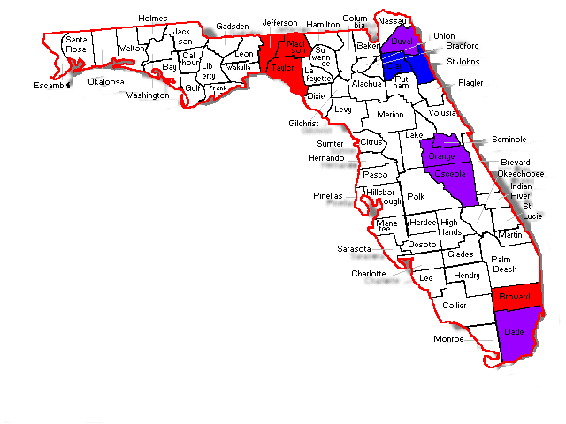
IMPACT
Statewide Reach
Blue: Cohort 1 counties
Red: Cohort 2 counties
Purple: counties in both cohorts
 | Children Reached | Programs Reached | Collaboratives
Cohort 1 | 14,463 | 179 | 9
Cohort 2 | 16,890 | 177 | 7
Total | 31,353 | 356 | 16

Slide 5
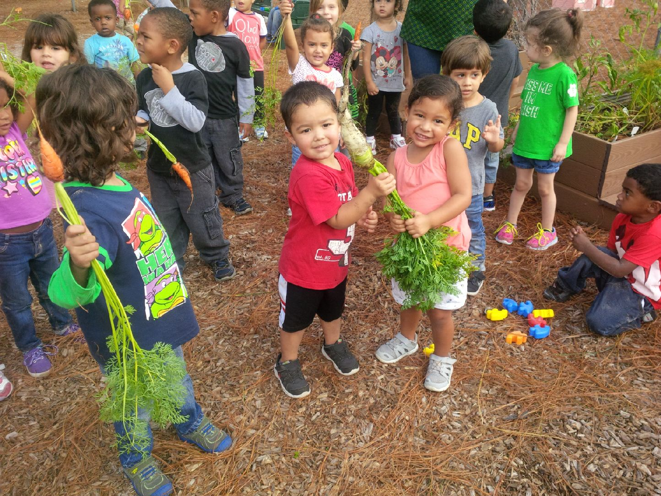
Thank you!

